Slide 1
8051 Timer

Slide 3
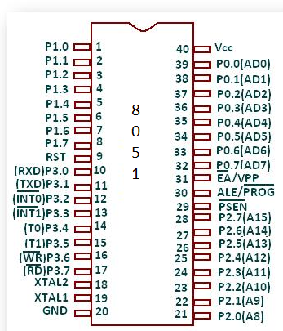
Pin Diagram

Slide 4
Pin Description of the 8051
8051 family members (e.g., 8751, 89C51, 89C52, DS89C4x0)
Have 40 pins dedicated for various functions such as I/O, RD, WR, address, data, and interrupts.
Come in different packages, such as
DIP(dual in-line package),
QFP(quad flat package), and
LLC(leadless chip carrier)
Some companies provide a 20-pin version of the 8051 with a reduced number of I/O ports for less demanding applications

Slide 5
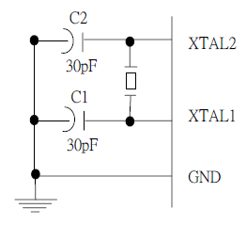
XTAL1 and XTAL2
The 8051 has an on-chip oscillator but requires an external crystal to run it
A quartz crystal oscillator is connected to inputs XTAL1 (pin19) and XTAL2 (pin18)
The quartz crystal oscillator also needs two capacitors of 30 pF value
The original 8051 operates at 12 MHZ

Slide 6
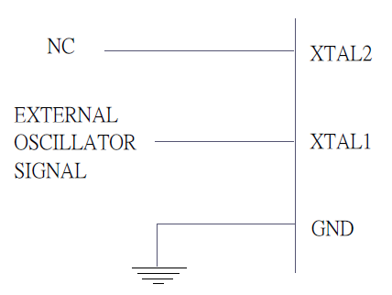
XTAL1 and XTAL2 …..
If you use a frequency source other than a crystal oscillator, such as a TTL oscillator:
It will be connected to XTAL1
XTAL2 is left unconnected

Slide 7
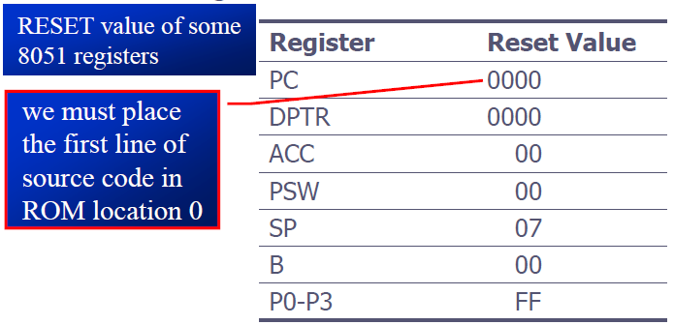
RST
RESET pin is an input and is active high (normally low)
Upon applying a high pulse to this pin, the microcontroller will reset and terminate all activities
This is often referred to as a power-on reset
Activating a power-on reset will cause all values in the registers to be lost

Slide 8
EA’
EA’, “external access’’, is an input pin and must be connected to Vcc or GND
The 8051 family members all come with on-chip ROM to store programs and also have an external code and data memory.
Normally EA pin is connected to Vcc (Internal Access)
EA pin must be connected to GND to indicate that the code or data is stored externally.

Slide 9
PSEN’ and ALE
PSEN, “program store enable’’, is an output pin
This pin is connected to the OE pin of the external memory.
For External Code Memory, PSEN’ = 0
For External Data Memory, PSEN’ = 1
ALE pin is used for demultiplexing the address and data.

Slide 10
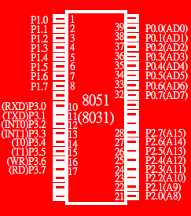
I/O Port Pins
The four 8-bit I/O ports P0, P1, P2 and P3 each uses 8 pins.
All the ports upon RESET are configured as output, ready to be used as input ports by the external device.

Slide 11
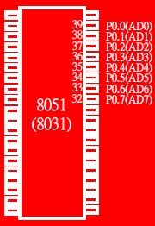
Port 0
Port 0 is also designated as AD0-AD7.
When connecting an 8051 to an external memory, port 0 provides both address and data.
The 8051 multiplexes address and data through port 0 to save pins.
ALE indicates if P0 has address or data.
When ALE=0, it provides data D0-D7
When ALE=1, it has address A0-A7

Slide 12
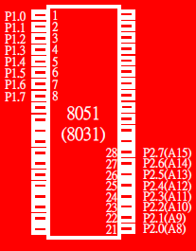
Port 1 and Port 2
In 8051-based systems with no external memory connection:
Both P1 and P2 are used as simple I/O.
In 8051-based systems with external memory connections:
Port 2 must be used along with P0 to provide the 16-bit address for the external memory.
P0 provides the lower 8 bits via A0 – A7.
P2 is used for the upper 8 bits of the 16-bit address, designated as A8 – A15, and it cannot be used for I/O.

Slide 13
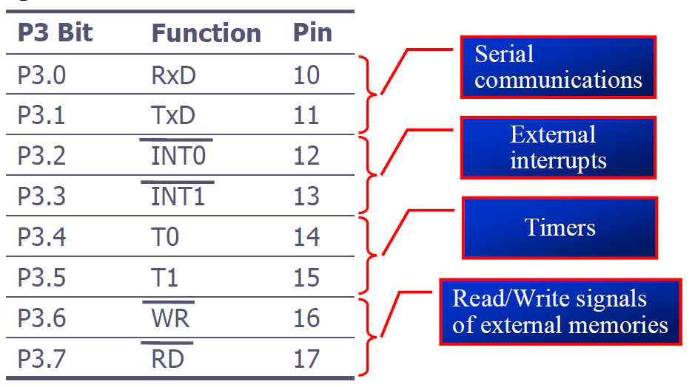
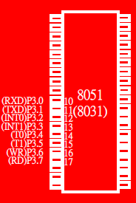
Port 3
Port 3 can be used as input or output.
Port 3 has the additional function of providing some extremely important signals

Slide 14
Pin Description Summary
PIN | TYPE | NAME AND FUNCTION
Vss | I | Ground: 0 V reference.
Vcc | I | Power Supply: This is the power supply voltage for normal, idle, and power-down operation.
P0.0 - P0.7 | I/O | Port 0: Port 0 is an open-drain, bi-directional I/O port. Port 0 is also the multiplexed low-order address and data bus during accesses to external program and data memory.
P1.0 - P1.7 | I/O | Port 1: Port I is an 8-bit bi-directional I/O port.
P2.0 - P2.7 | I/O | Port 2: Port 2 is an 8-bit bidirectional I/O. Port 2 emits the high order address byte during fetches from external program memory and during accesses to external data memory that use 16 bit addresses.
P3.0 - P3.7 | I/O | Port 3: Port 3 is an 8 bit bidirectional I/O port. Port 3 also serves special features as explained.

Slide 15
Pin Description Summary
PIN | TYPE | NAME AND FUNCTION
RST | I | Reset: A high on this pin for two machine cycles while the oscillator is running, resets the device.
ALE | O | Address Latch Enable: Output pulse for latching the low byte of the address during an access to external memory.
PSEN* | O | Program Store Enable: The read strobe to external program memory. When executing code from the external program memory, PSEN* is activated twice each machine cycle, except that two PSEN* activations are skipped during each access to external data memory.
EA*/VPP | I | External Access Enable/Programming Supply Voltage: EA* must be externally held low to enable the device to fetch code from external program memory locations. If EA* Is held high, the device executes from internal program memory. This pin also receives the programming supply voltage Vpp during Flash programming. (applies for 89c5x MCU's)

Slide 16
Timers
Base 8051 has 2 timers
Timer mode
Increments every machine cycle (12 clock cycles)
Counter mode
Increments when T0/T1 go from 1 - 0 (external signal)
Access timer value directly
Timer can cause an interrupt
Timer 1 can be used to provide programmable baud rate for serial communications
Timer/Counter operation
Mode control register (TMOD)
Control register (TCON)

Slide 17


8051 Timer/Counter
OSC
÷12
TLx
(8 Bit)
THx
(8 Bit)
TFx
(1 Bit)
INTERRUPT

Slide 18
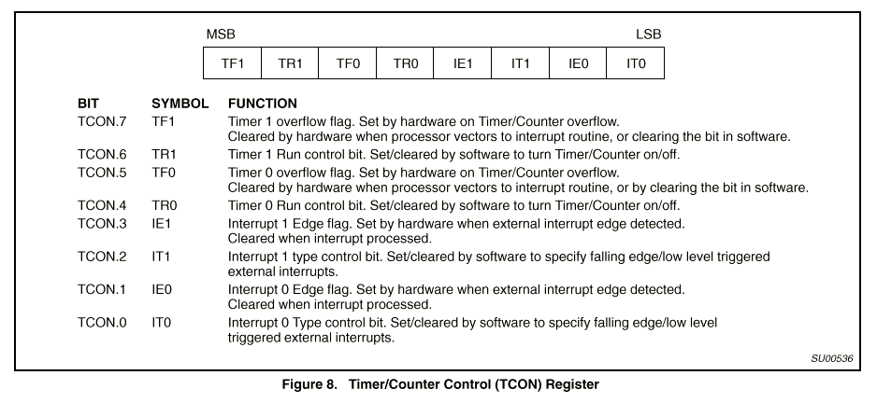
Timer/Counter Control Register (TCON)
TR - enable timer/counter
TF - overflow flag: can cause interrupt
IE/IT - external interrupts and type control
not related to the timer/counter

Slide 19
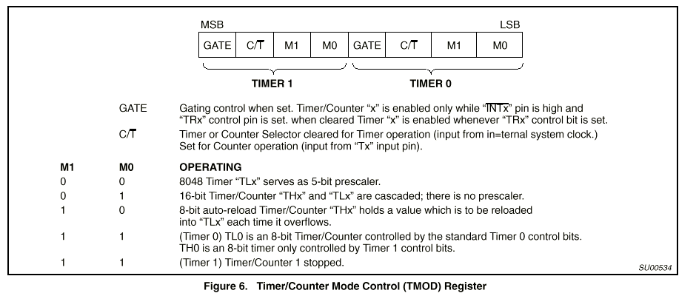
Mode Control Register (TMOD)
Modes 0-3
GATE - allows external pin to enable timer (e.g. external pulse)
0: INT pin not used
1: counter enabled by INT pin (port 3.2, 3.3)
C/T - indicates timer or counter mode

Slide 21
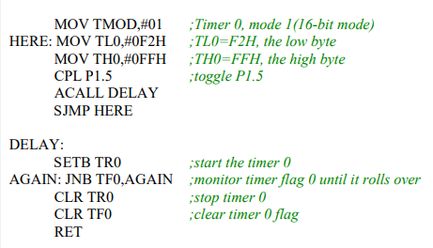
Example 1 In the following program, we create a square wave of 50% duty cycle (with equal portions high and low) on the P1.5 bit. Timer 0 is used to generate the time delay. Analyze the program. Also calculate the delay generated. Assume XTAL=11.0592MHz.

